Slide 1
Works
1
Literature comparison (In progress)
2
CPTAC-COAD for internal dataset and TCGA-COAD for external dataset
3
Thesis outline
(introduction, materials & methods, results, discussion and conclusion)
4
DLMI course project
5
Finish AACR 國科會補助核銷 and 出國報告

Slide 2
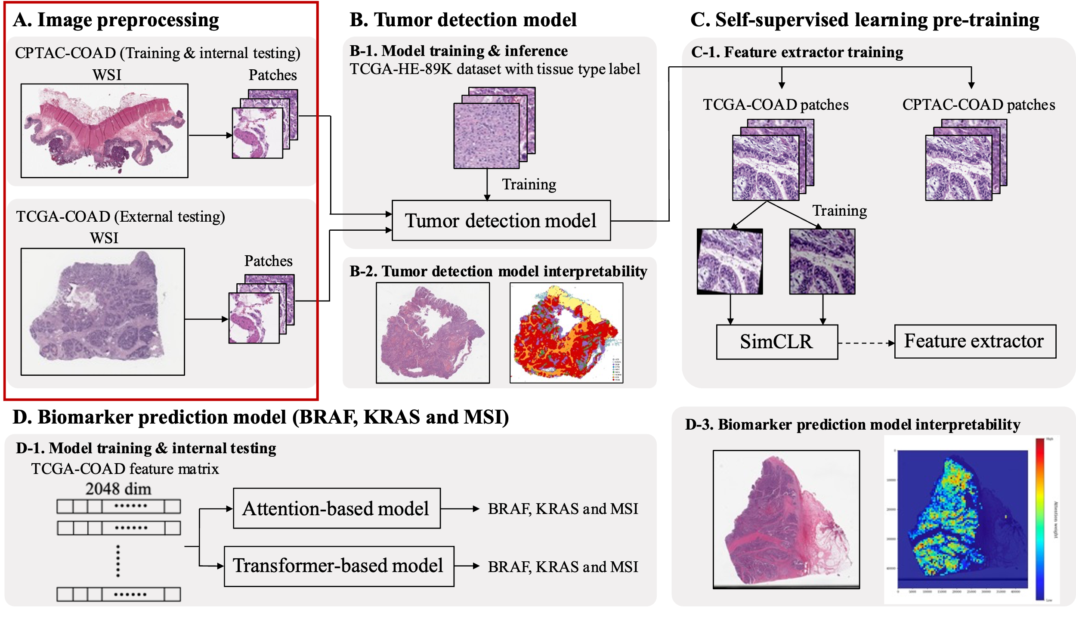

Slide 3
Thesis outline
Chapter 1. Introduction
1.1 Colon Cancer
1.2 Generalizable Biomarker for Colon Cancer
1.2.1 BRAF
1.2.2 KRAS
1.2.3 Microsatellite Instability
1.3 Biomarker Screening
1.4 Digital Pathology
1.5 Artificial Intelligence
1.5.1 Machine Learning
1.5.2 Deep Learning
1.5.2.1 Deep Neural Network
1.5.2.2 Convolutional Neural Network
1.5.2.3 Loss Function
1.5.2.4 Optimization
1.5.3 Self-supervised Learning
1.5.3 Multiple Instance Learning
1.5.4 MIL Attention Mechanism
1.5.5 Self-attention Mechanism
1.6 Specific Aims

Slide 4
Thesis outline
Chapter 2. Materials and Methods
2.1 Overview of proposed pipeline
2.2 Materials
2.2.1 Public Cohort
2.2.1.1 TCGA-COAD
2.2.1.2 CPTAC-COAD
2.2.2 Whole Slide Images
2.2.3 Biomarker Labels
2.2.4 Tissue Category Dataset in Patch Level
2.3 Whole Slide Image Preprocessing
2.3.1 Patch Segmentation
2.3.2 Color Normalization
2.3.3 Blur Removal
2.4 Tumor Detection Model
2.5 Tumor Detection Model Development
2.6 Self-supervised Learning Feature Extractor
2.7 Biomarker Prediction Model
2.7.1 Attention-based Multiple Instance Learning Model
2.7.2 Transformer-based Multiple Instance Learning Model
2.8 Biomarker Prediction Model Comparison

Slide 5
Thesis outline
Chapter 3. Results
Chapter 4. Discussion
3.1 Tumor detection model
3.2 Tumor detection model Interpretability
3.2.1 Grad-Cam analysis
3.2.2 Tissue category visualization
3.3 Self-supervised Learning Feature Extractor
3.4 BRAF Prediction
3.4.1 Attention-based Multiple Instance Learning Model
3.4.2 Transformer-based Multiple Instance Learning Model
3.5 KRAS Prediction
3.5.1 Attention-based Multiple Instance Learning Model
3.5.2 Transformer-based Multiple Instance Learning Model
3.6 MSI Prediction
3.6.1 Attention-based Multiple Instance Learning Model
3.6.2 Transformer-based Multiple Instance Learning Model
3.7 Biomarker Prediction Model Interpretability
4.1 Limitation
4.2 Future Application
Chapter 5. Conclusion

Slide 6
Future works
1
Write introduction, materials & methods (thesis)
2
Write paper manuscript

Slide 7
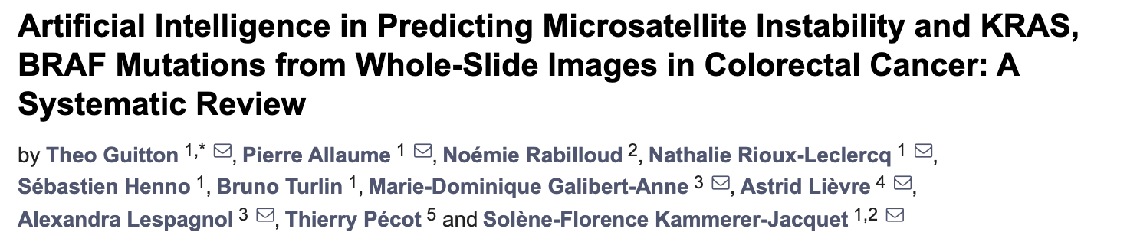
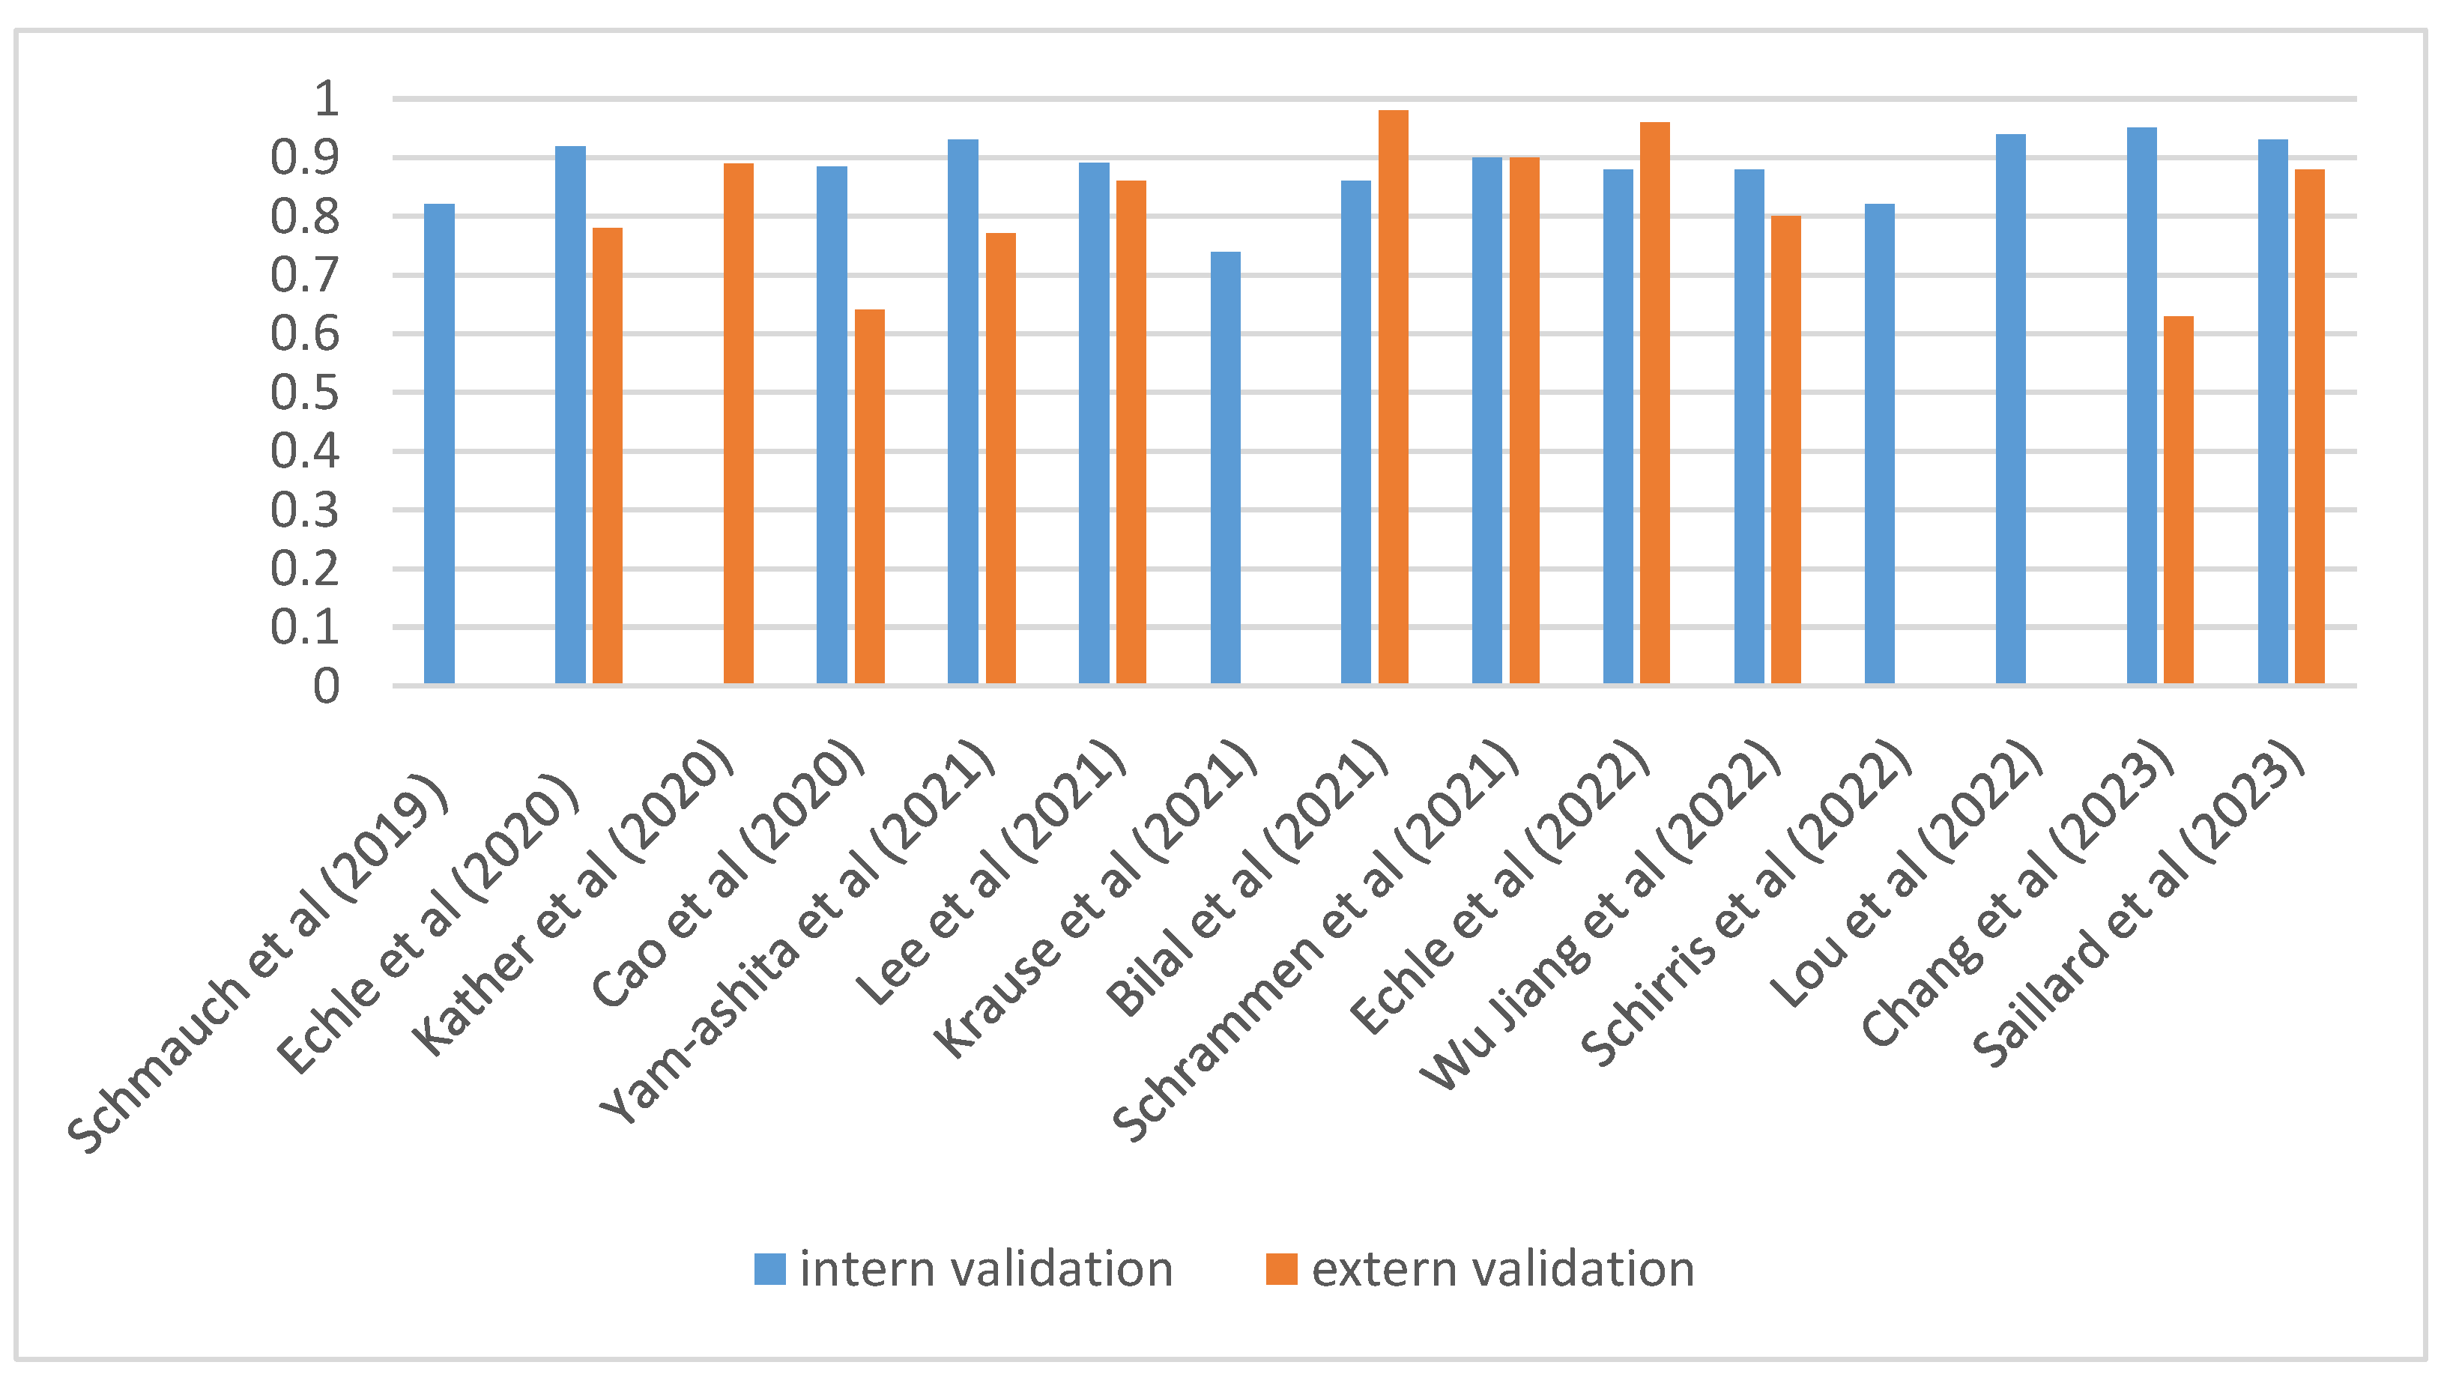
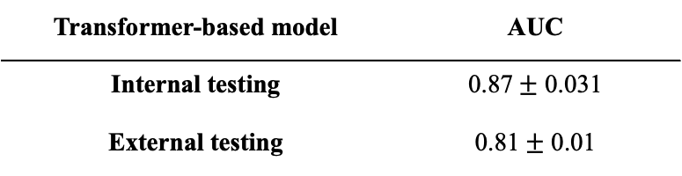
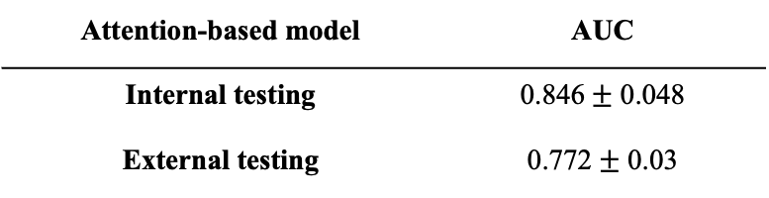
Literature comparison
MSI prediction
Attention-based model | AUC
Internal testing | 0.846$±$ 0.048
External testing | 0.772$±$ 0.03
Transformer-based model | AUC
Internal testing | 0.87$±$ 0.031
External testing | 0.81$±$ 0.01

Slide 8
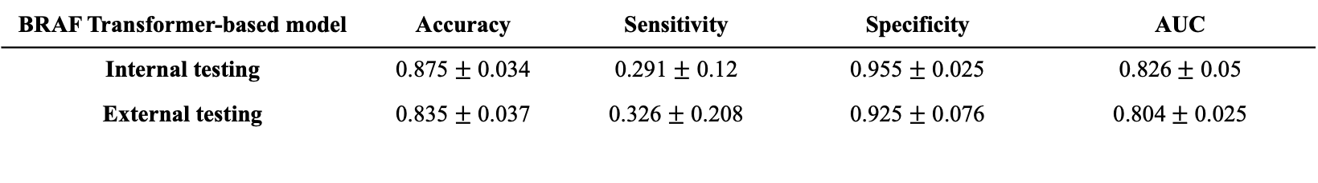
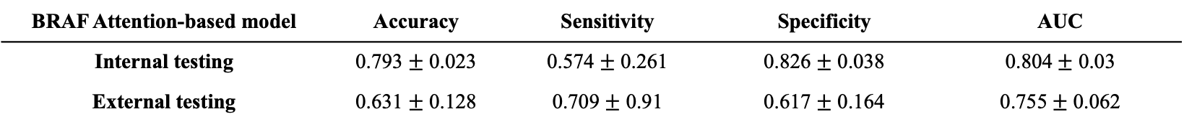
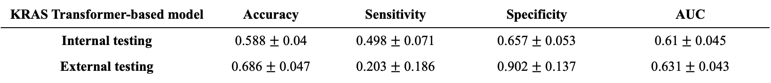
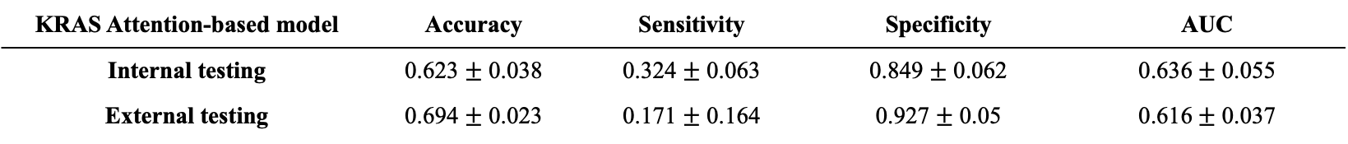
Literature comparison
BRAF and KRAS prediction
Some studies (n = 3) also explored the mutational status of KRAS and BRAF.
All studies had almost similar results when determining the KRAS mutation with an AUC of 0.6 approximately
Schrammen et al. used the most data with DACHS (n = 2448) and obtained the best result to determine the BRAF mutation with an AUC of 0.82
BRAF Attention-based model | Accuracy | Sensitivity | Specificity | AUC
Internal testing | 0.793 $±$ 0.023 | 0.574 $±$ 0.261 | 0.826 $±$ 0.038 | 0.804$±$ 0.03
External testing | 0.631 $±$ 0.128 | 0.709 $±$ 0.91 | 0.617 $±$ 0.164 | 0.755$±$ 0.062
BRAF Transformer-based model | Accuracy | Sensitivity | Specificity | AUC
Internal testing | 0.875 $±$ 0.034 | 0.291 $±$ 0.12 | 0.955 $±$ 0.025 | 0.826$±$ 0.05
External testing | 0.835 $±$ 0.037 | 0.326 $±$ 0.208 | 0.925 $±$ 0.076 | 0.804$±$ 0.025
KRAS Attention-based model | Accuracy | Sensitivity | Specificity | AUC
Internal testing | 0.623 $±$ 0.038 | 0.324 $±$ 0.063 | 0.849 $±$ 0.062 | 0.636$±$ 0.055
External testing | 0.694 $±$ 0.023 | 0.171 $±$ 0.164 | 0.927 $±$ 0.05 | 0.616$±$ 0.037
KRAS Transformer-based model | Accuracy | Sensitivity | Specificity | AUC
Internal testing | 0.588 $±$ 0.04 | 0.498 $±$ 0.071 | 0.657 $±$ 0.053 | 0.61$±$ 0.045
External testing | 0.686 $±$ 0.047 | 0.203 $±$ 0.186 | 0.902 $±$ 0.137 | 0.631$±$ 0.043

